Slide 1



Safe2Say South Dakota
Make a Report. Make a Difference.
Mission: Keeping South Dakota a Safe Place to Live, Work, Visit and Raise a Family

Slide 2
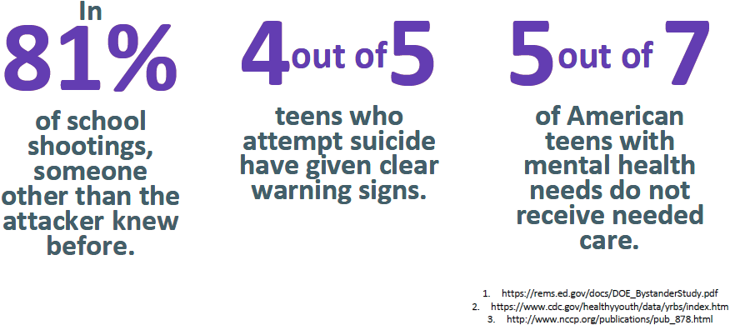
WHY?

Slide 3

What is Safe2Say South Dakota?
  Free anonymous K-12 school safety reporting system.
  Helps students, teachers, parents, and community members keep South Dakota safe.
  Helps identify and provide intervention for students in crisis before they harm themselves or others.
Notes:
What is Safe2Say South Dakota?
It’s a free anonymous safety reporting system available to all K-12 schools in South Dakota.
Safe2Say South Dakota was developed by the South Dakota School Safety Center to provide students, teachers, parents and other community members a way to help identify and provide intervention for students in crisis before they harm themselves or others.

Slide 4

Safe2Say South Dakota
Helps prevent:
School violence
Unlawful possession of weapons
Self-harm
Other forms of victimization
and threatening behavior
Helps enable:
School administrators and law enforcement to work together for effective interventions
|
Notes:
The intent of Safe2Say South Dakota is to help prevent school violence, unlawful possession of weapons, self-harm and other forms of victimization and threatening behavior.
The free anonymous school safety reporting system relays information between those who report safety concerns and local teams that include schools, law enforcement agencies, and sometimes mental health resources, helping them work together to respond to students in crisis.
Safe2Say South Dakota allows communities to act, not react, to the critical issue of school safety.

Slide 5




Connecting Concerns, Creating Action
Free anonymous school safety reporting system:
Safety concerns of students, teachers, parents and community members
Safe2Say South Dakota
Local school contacts, law enforcement
and/or other
community partners
Outreach and support
to student in crisis
Notes:
Safe2Say South Dakota acts as the liaison for those reporting a safety concern and local school administration, law enforcement and other community partners, so the right steps by the right people can be taken to prevent a tragedy.
Safe2Say South Dakota provides an efficient, effective and holistic approach for quickly engaging school administrators, law enforcement and other community resources so they can work together to respond to students in crisis and provide support.

Slide 6
Safe2Say South Dakota:
Offers Early Intervention
Identify and help a student who is struggling before they cause harm to
themselves or others
Empowers Students
Advocate for your school and community by speaking out for others
to play a role in keeping everyone safe
Strengthens Community
Support communities in working together to prevent and protect against acts of violence

Slide 7
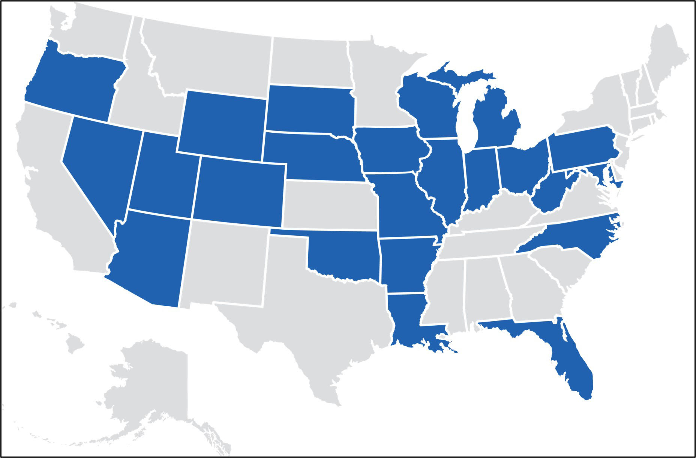
Joining A Proven Model
South Dakota has joined a growing list of states that are making school safety programs a priority, including: Arizona, Arkansas, Colorado, Florida, Illinois, Indiana, Iowa, Louisiana, Maryland, Michigan, Missouri, Nebraska, Nevada, North Carolina, Ohio, Oklahoma, Oregon, Pennsylvania, Utah, West Virginia, Wisconsin and Wyoming.

Slide 8
While it is a school safety tip line, it is free to the public and available to any member of the public to report a safety concern.

Slide 9

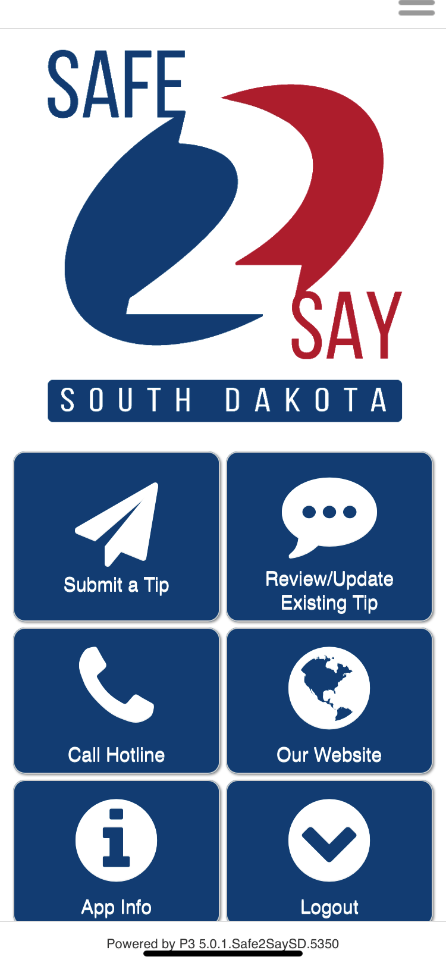




Mobile
Notes:
School Safety Concerns may be reported securely and anonymously using:
Free mobile App-Safe2Say South Dakota

Slide 10

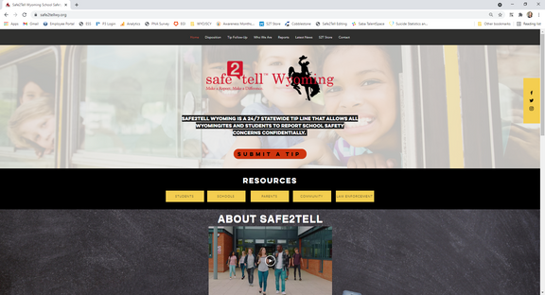
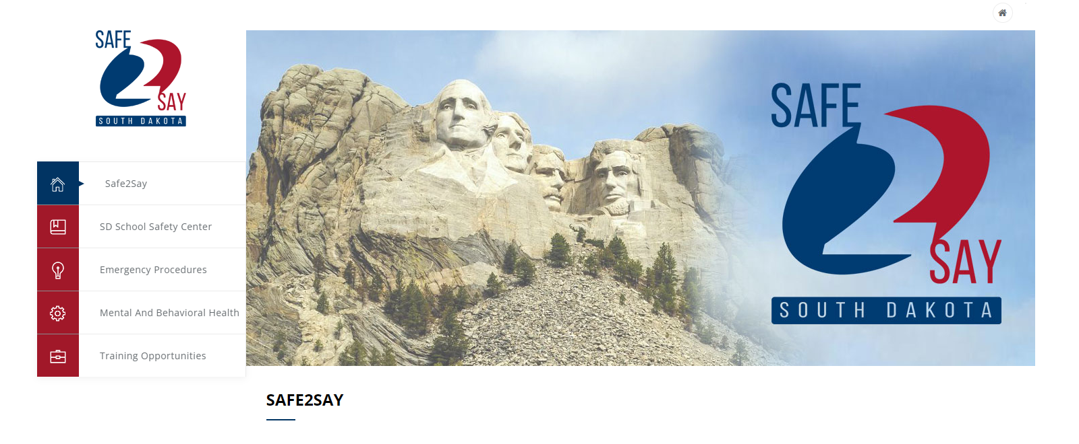

Web!
www.safe2say.sd.gov
Notes:
School Safety Concerns may be reported securely and anonymously using:
Online at Safe2Say.sd.gove (Make a Report)

Slide 11

Phone!
1-844-3SD-SAFE
1-844-373-7233
Notes:
School Safety Concerns may be reported securely and anonymously using:
Or by calling the toll-free number 1-844-3SD-SAFE/1-844-373-7233

Slide 12

What can you report?
When someone is being hurt, self harming, or expressing suicidal thoughts.

Slide 13

What can you report?
If someone is saying something that scares or worries you.

Slide 14

What can you report?
When someone is in danger.

Slide 15
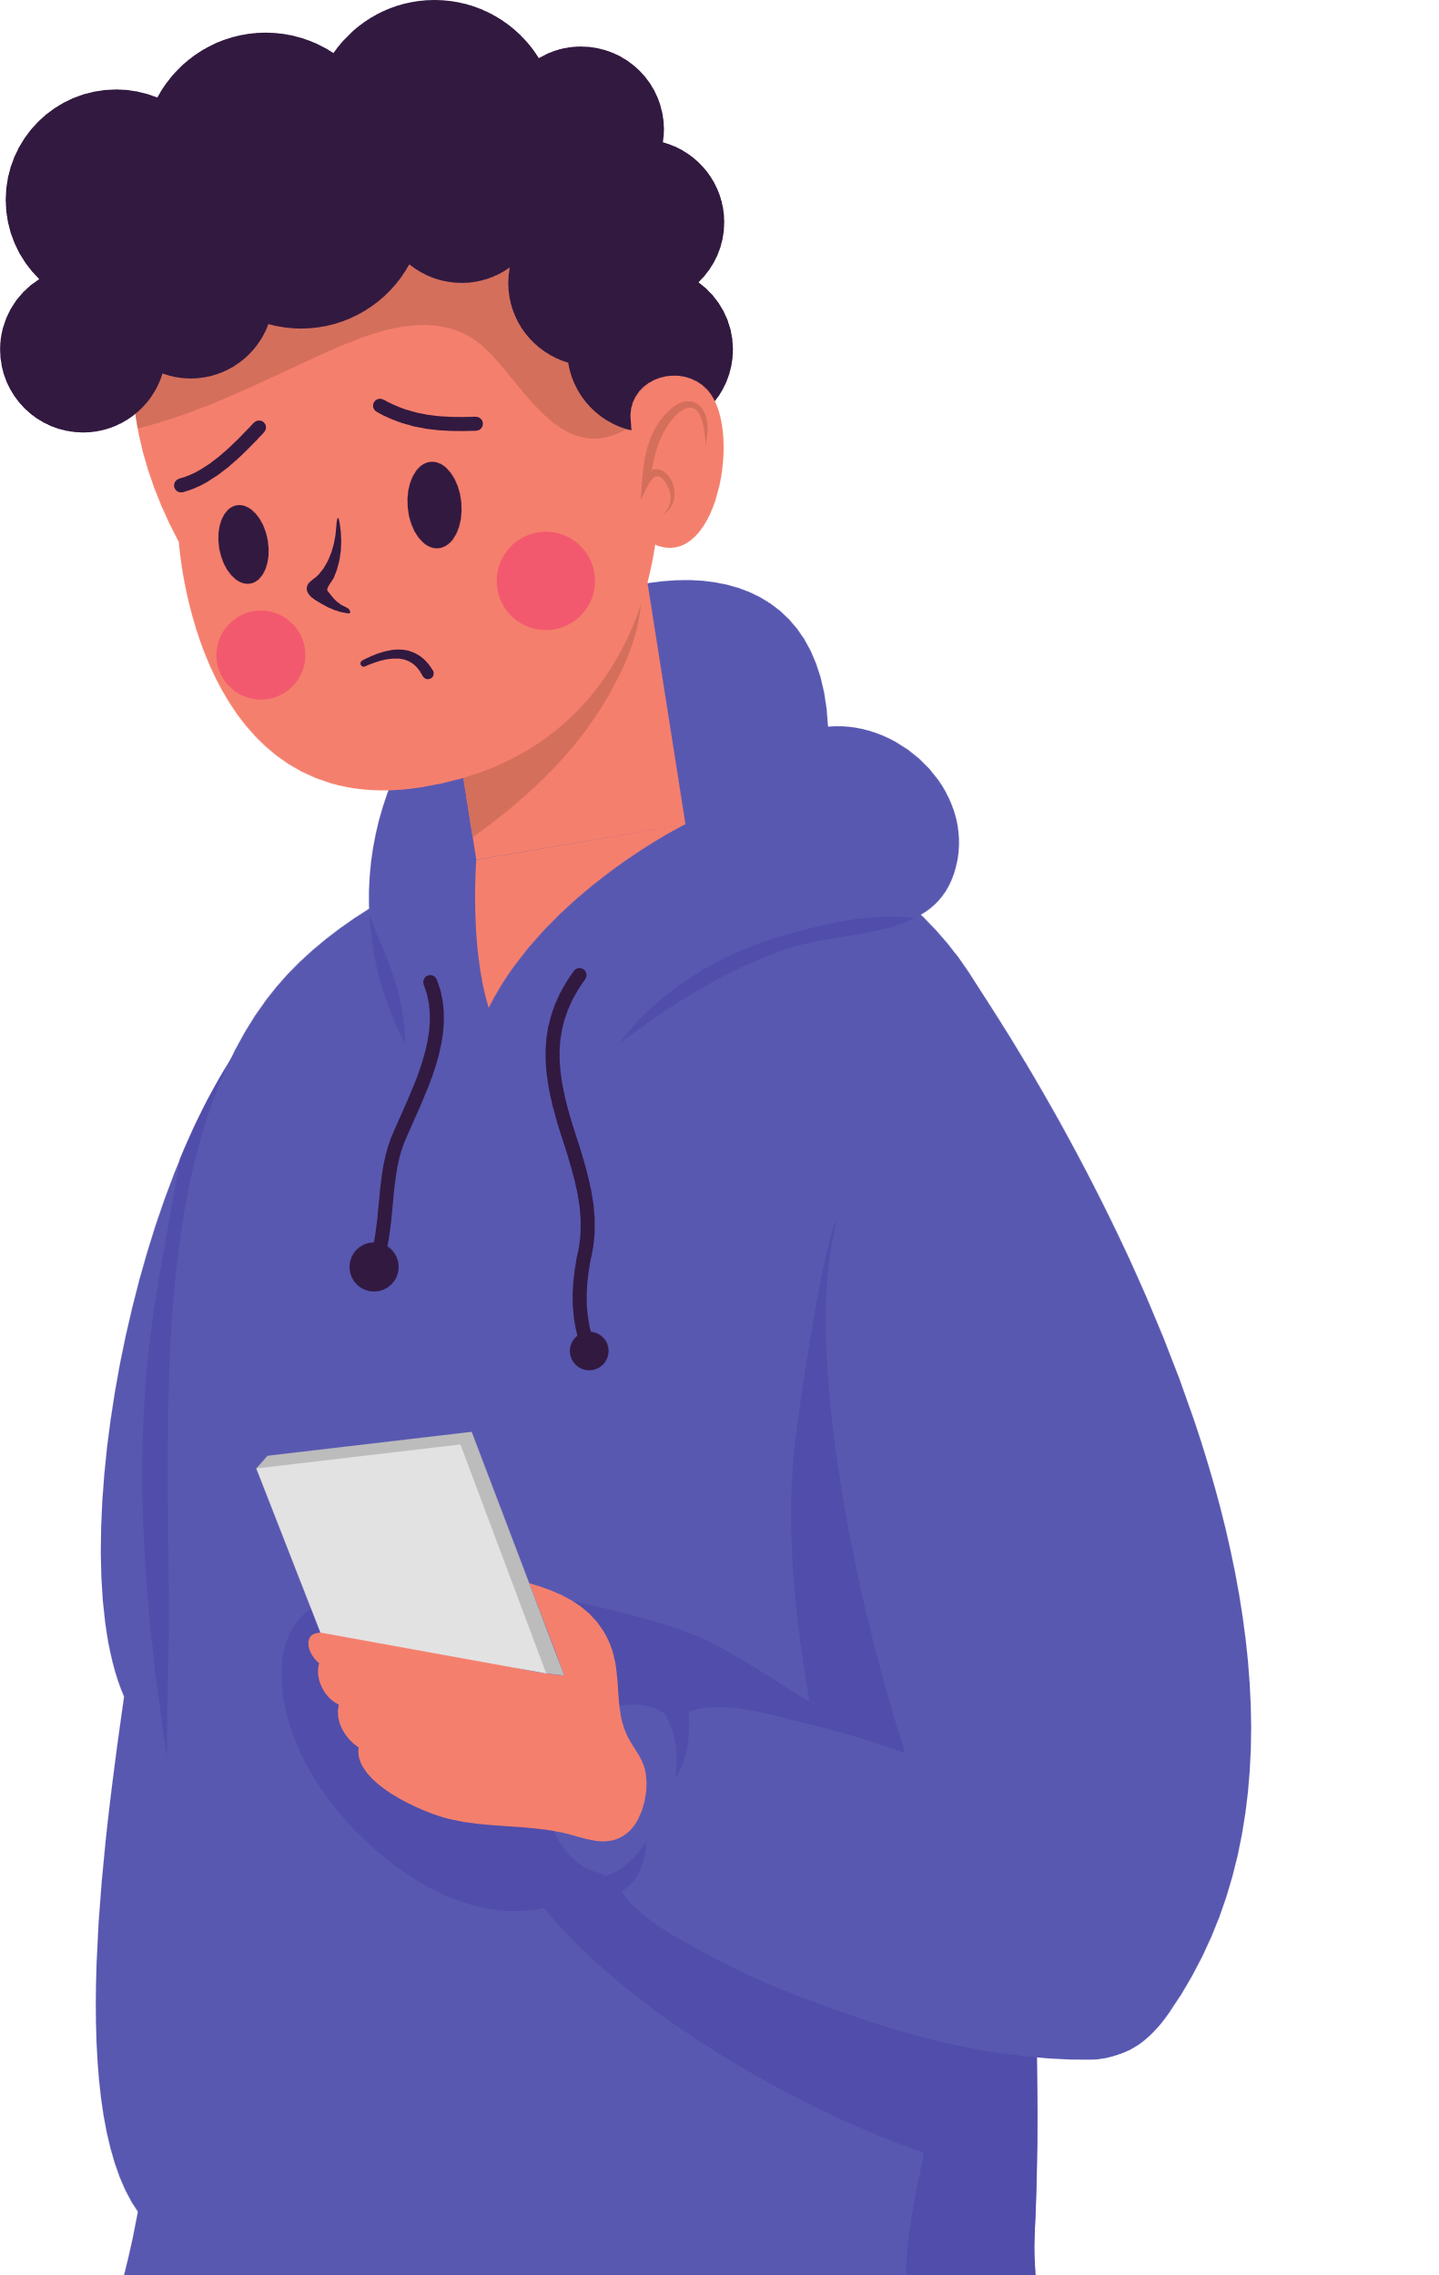
What can you report?
When someone is bullying, sextorting, or cyberbullying.

Slide 16


What can you report?
Depression
Or anything else that makes you or someone else feel unsafe.
Weapons on campus
Sexual
Assault
Suicidal
thoughts

Slide 17
What to
Alcohol
Assault/Intent to Harm Others
Bodily Injury/Emergency Condition
Bullying / Cyberbullying
Child Abuse
Dating Violence
Depression / Anxiety
Domestic Violence
Drugs
Fighting
Gang Violence
Guns / Weapons
Hate Crime / Hate Speech
Harassment
Hazing
Homicide
Human Trafficking
Location of Missing Child / Student
Physical Abuse
Planned Fight
Planned School Attack
Reckless Behavior
Sexting
Sexual Assault / Rape
Smoking / Vaping / e-Cigs
Suicide Threat
Threats of Violence
Theft / Stealing
Vandalism

Slide 18
You can make reports to Safe2Say in the form of:
Notes:
You can attach various things to your report.

Slide 19
/
/

Slide 20
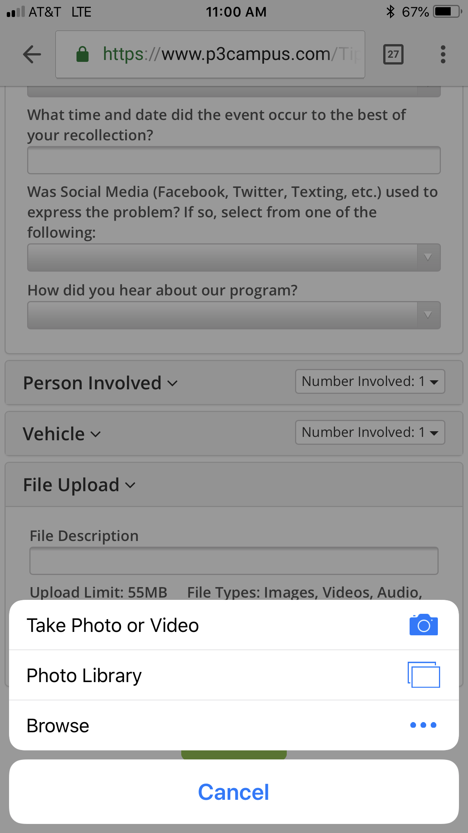
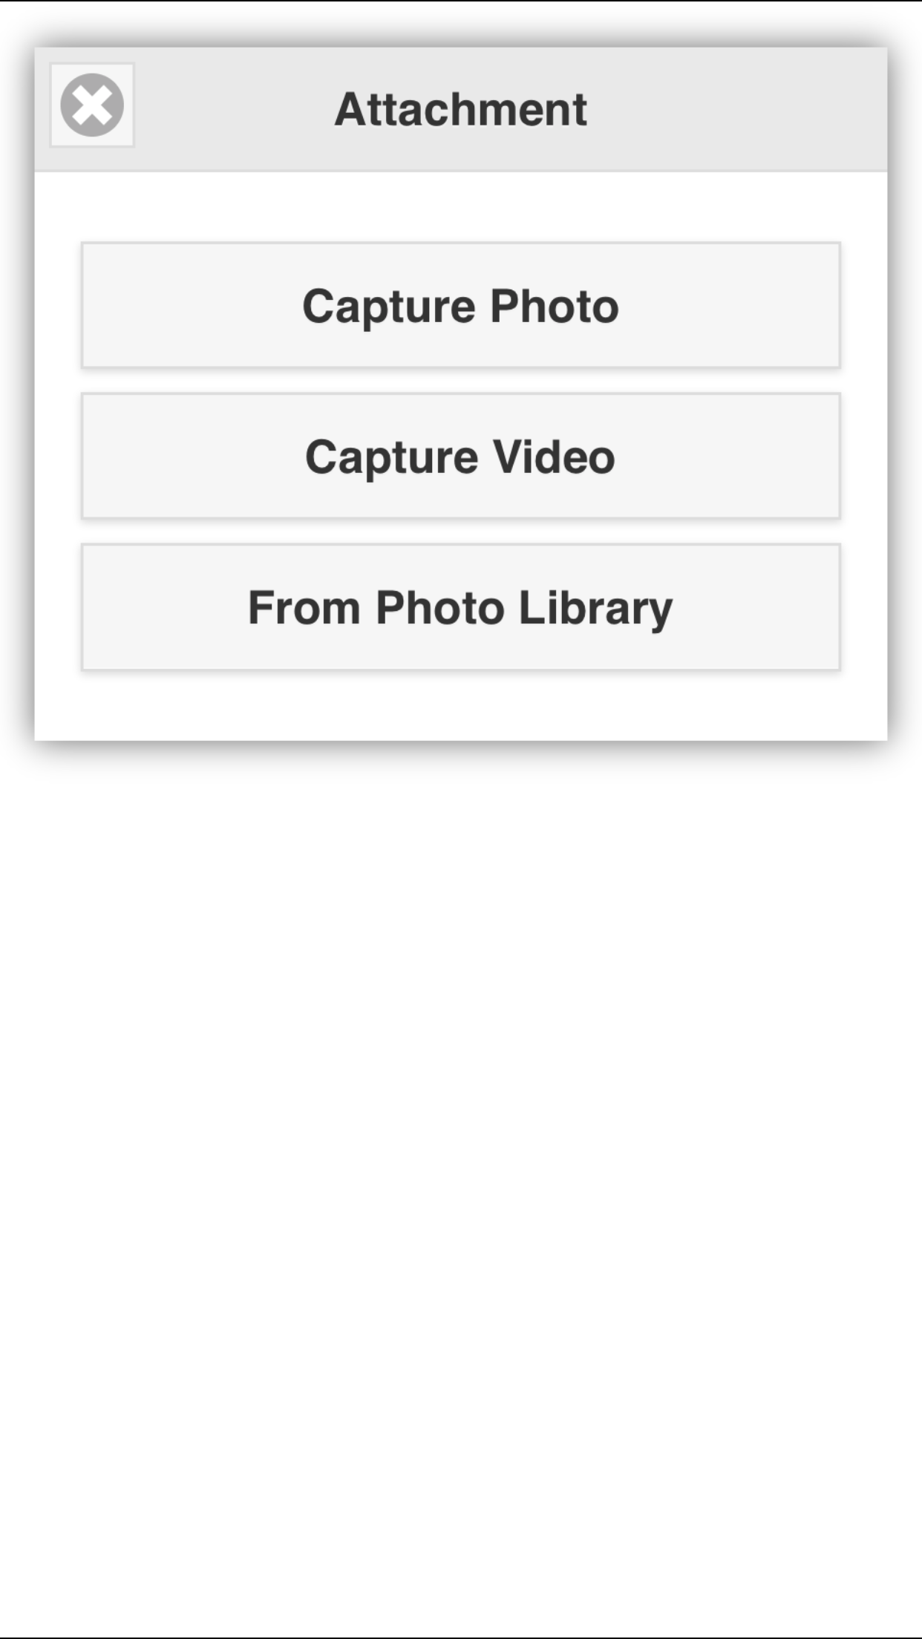
ADDING ATTACHMENTS

Slide 21
You can engage in two-way dialogue with a trained dispatcher.
Notes:
They will probably ask kids for more details. It’s totally optional. This can be done through both the web browser and mobile app.

Slide 22
Reports are handled by a diverse team of experts.
Notes:
Clearly we wouldn’t want cops trying to address something like an eating disorder, right? And we wouldn’t want a counselor to address something like someone with a gun in school.

Slide 23
This ensures that your reports are handled properly and responsibly.
Notes:
Clearly we wouldn’t want cops trying to address something like an eating disorder, right? And we wouldn’t want a counselor to address something like someone with a gun in school.

Slide 24
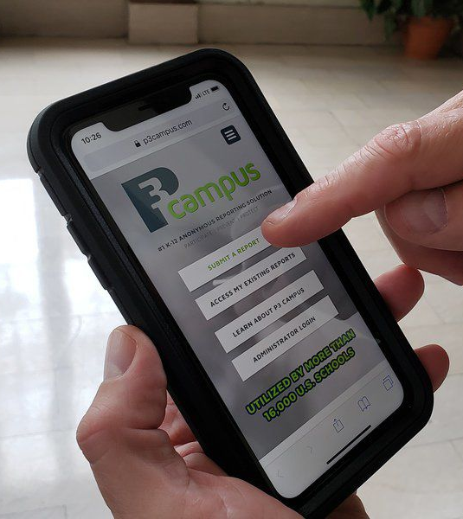
How it Works
Tipster submits a tip from any web-enabled device or phone call.
Gatekeepers engage in real-time dialog with tipster to gather timely and additional info.
Gatekeepers vet the tip for validity and potentially sanitize the tip for anonymity.
Gatekeepers deliver the tip to pre-defined recipients (School, LE Agency, Clinics, etc.).
Content will determine WHO will respond to the report and how the situation will be addressed.

Slide 25

How to Make a Report
Frequently Asked Questions
When I make a report, how does Safe2Say South Dakota protect my anonymity?
Safe2Say South Dakota will only ask for details about the situation causing concern. You
will not be asked to provide your name, contact information or any other identifying information when making a report.
How much information do I need to know about a situation before I make a report?
If you have a safety concern about a student at risk for harming themselves or others,
you should make a report as soon as possible with the information you have.
When a report is made about a student, how is the student’s information protected?
Safe2Say South Dakota reporting information is kept confidential and is not subject to disclosure under South Dakota open records laws. Threat report information is only shared with designated school staff and law enforcement with a right and need to know to address reported concerns.

Slide 26
Reports will be read and responded to 24/7.

Slide 27
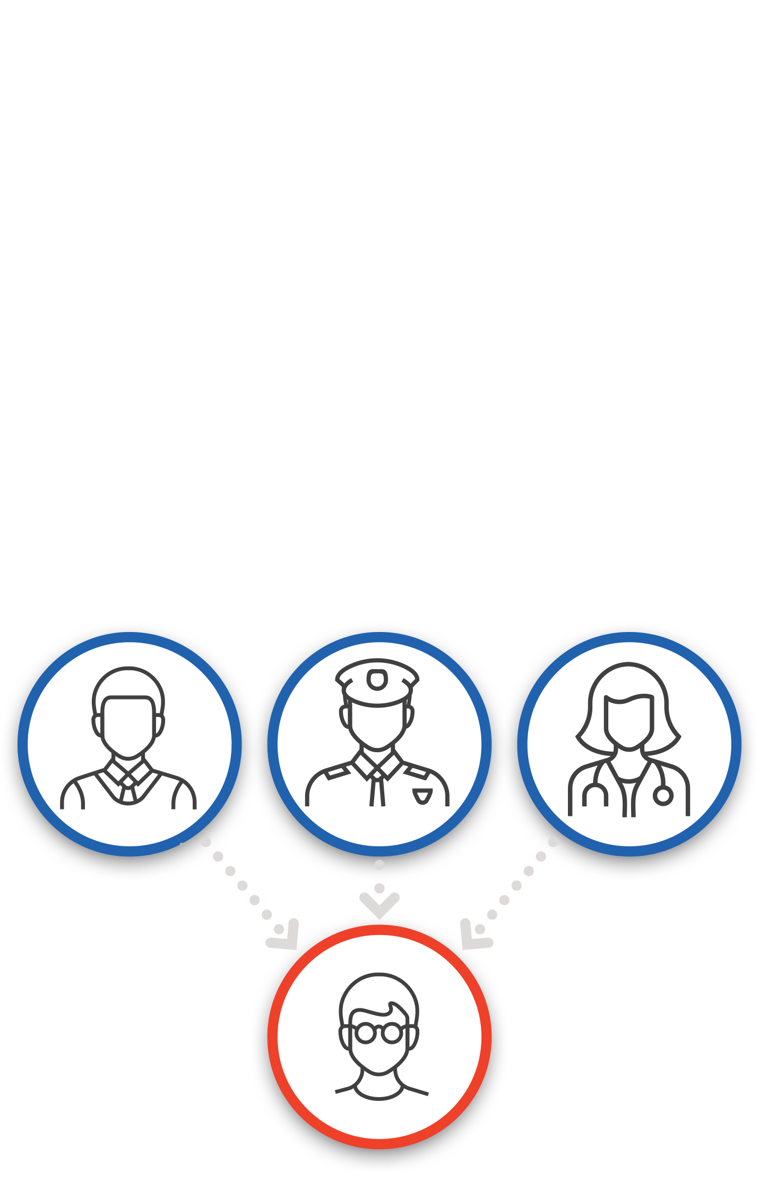
Lifecycle of a Report
The student in crisis or at risk receives the help they need BEFORE they ever get to the point of harming themselves or others.
The report is closed by the responding local school or
law enforcement official.
Notes:
The student in crisis or at-risk receives the help they need BEFORE they ever get to the point of harming themselves or others.

Slide 28
Lifecycle of a Report
Frequently Asked Questions
Am I able to find out how my reported safety concern was resolved?
No. Because reports are anonymous and all information is confidential, you will not be informed of how a situation was resolved.
How does Safe2Say South Dakota determine which school and/or law enforcement official to contact when a report is made?
Your community’s school administrators and local law enforcement partners have been identified and added as contacts to be included as part of the Safe2Say South Dakota school safety reporting system.

Slide 29

Goal of Safe2Say South Dakota
To intervene at the earliest possible point in the life of a young person who is struggling, helping when they need it before the situation turns into a tragedy.

Slide 30
What Safe2Say South Dakota is Not
  Safe2Say South Dakota is not a mental health response or resource unit
  A replacement for a trusted adult

Slide 31
False Reporting
Safe2Say South Dakota is intended to be a school violence prevention program to save lives. The website, mobile app, and tip line should be used responsibly to report school safety concerns.
Like misusing 911 or filing a false police report, knowingly submitting a false report to Safe2Say South Dakota could have serous consequences, including being charged with a crime.
Notes:
Stress this to your students if you are talking to them about the program.

Slide 32
Thank you for your time and interest in the Safe2Say South Dakota program!

Slide 33
  Questions?
  Email School Safety Program Director Brett Garland
  Brett.Garland@state.sd.us
  Find more information about Safe2Say South Dakota and the South Dakota School Safety Center at: https://safe2say.sd.gov/
  Safe2Say South Dakota is a program of the South Dakota Department of Public Safety.

